Slide 1
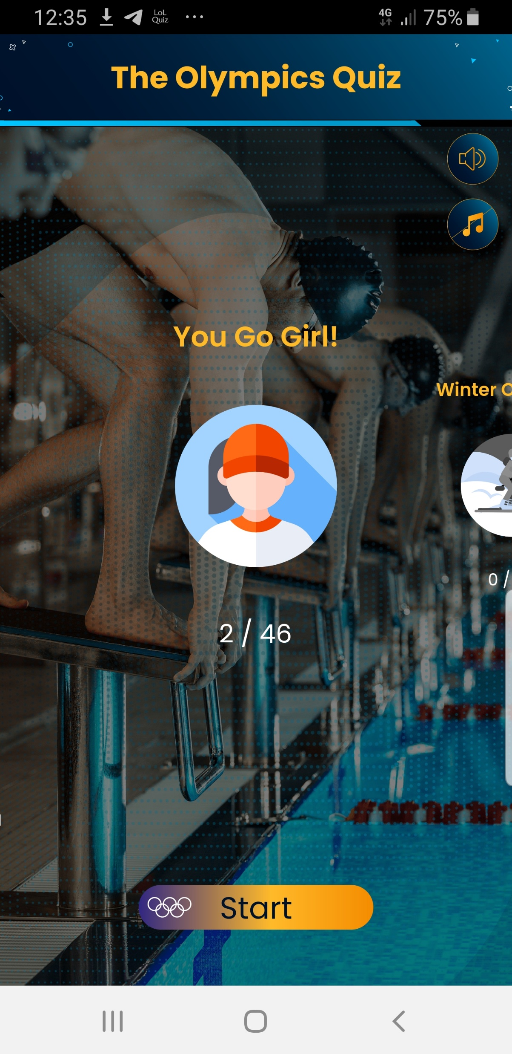
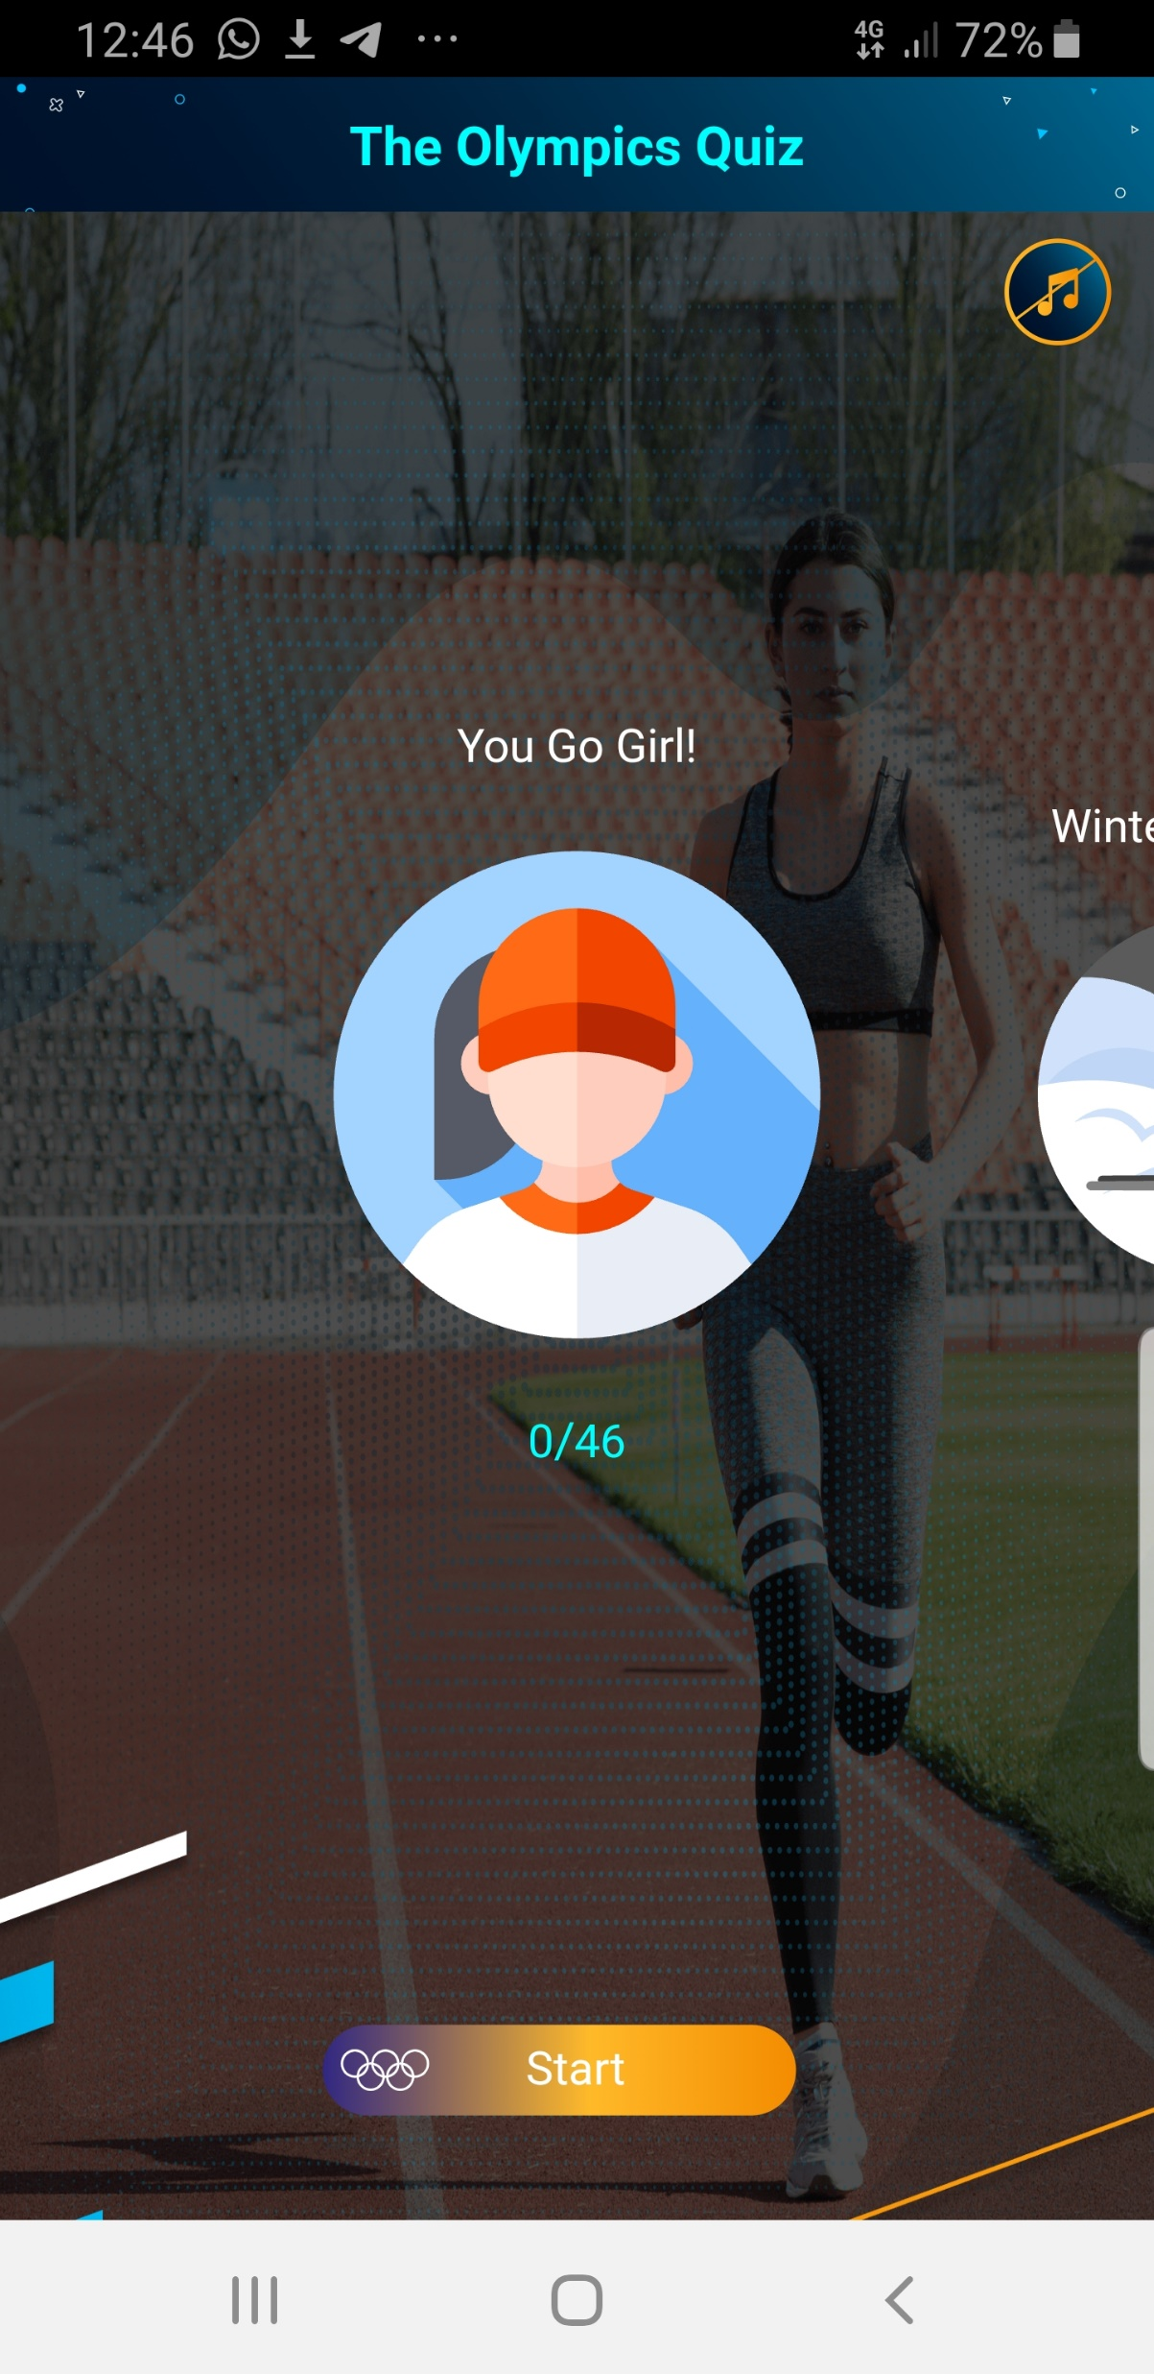
Original mobile app
New webapp
Sound effect icon is missing
title is not centered
This is the main screen, the background should be the file “default background” and should not be changes when user swipe categories
Font size and colors are not according to the original
Category icon size is bigger then the original
There is no preloaded like the original

Slide 2
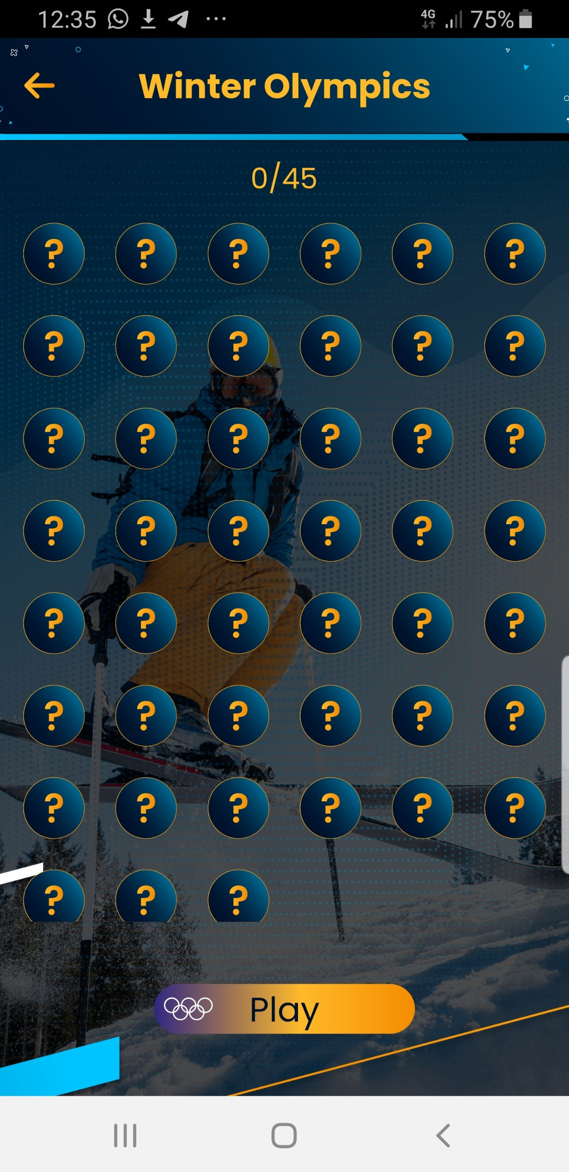
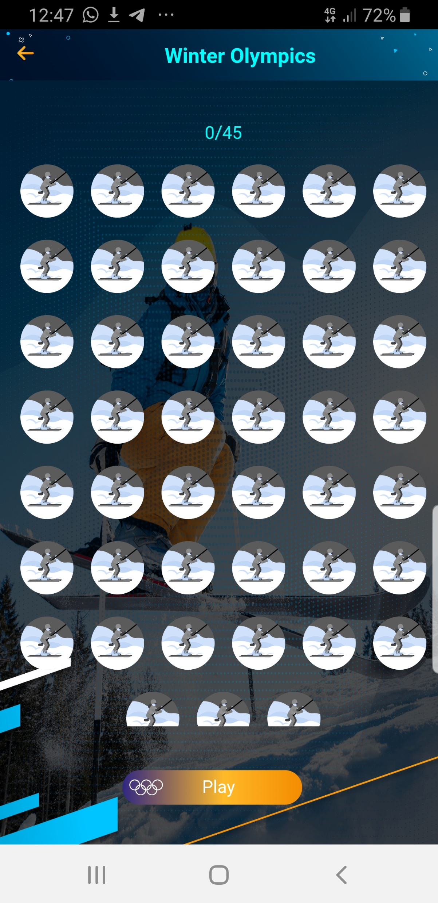
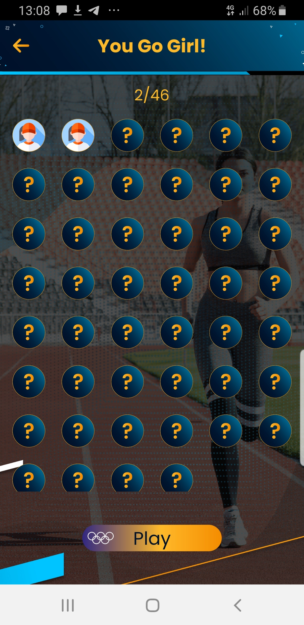
Original mobile app
New webapp
title is not centered
Font size and colors are not according to the original
Category screen- should be question marks , and only after answering question correct it changes to the icon- “answerd_question_catagoryname"

Slide 3
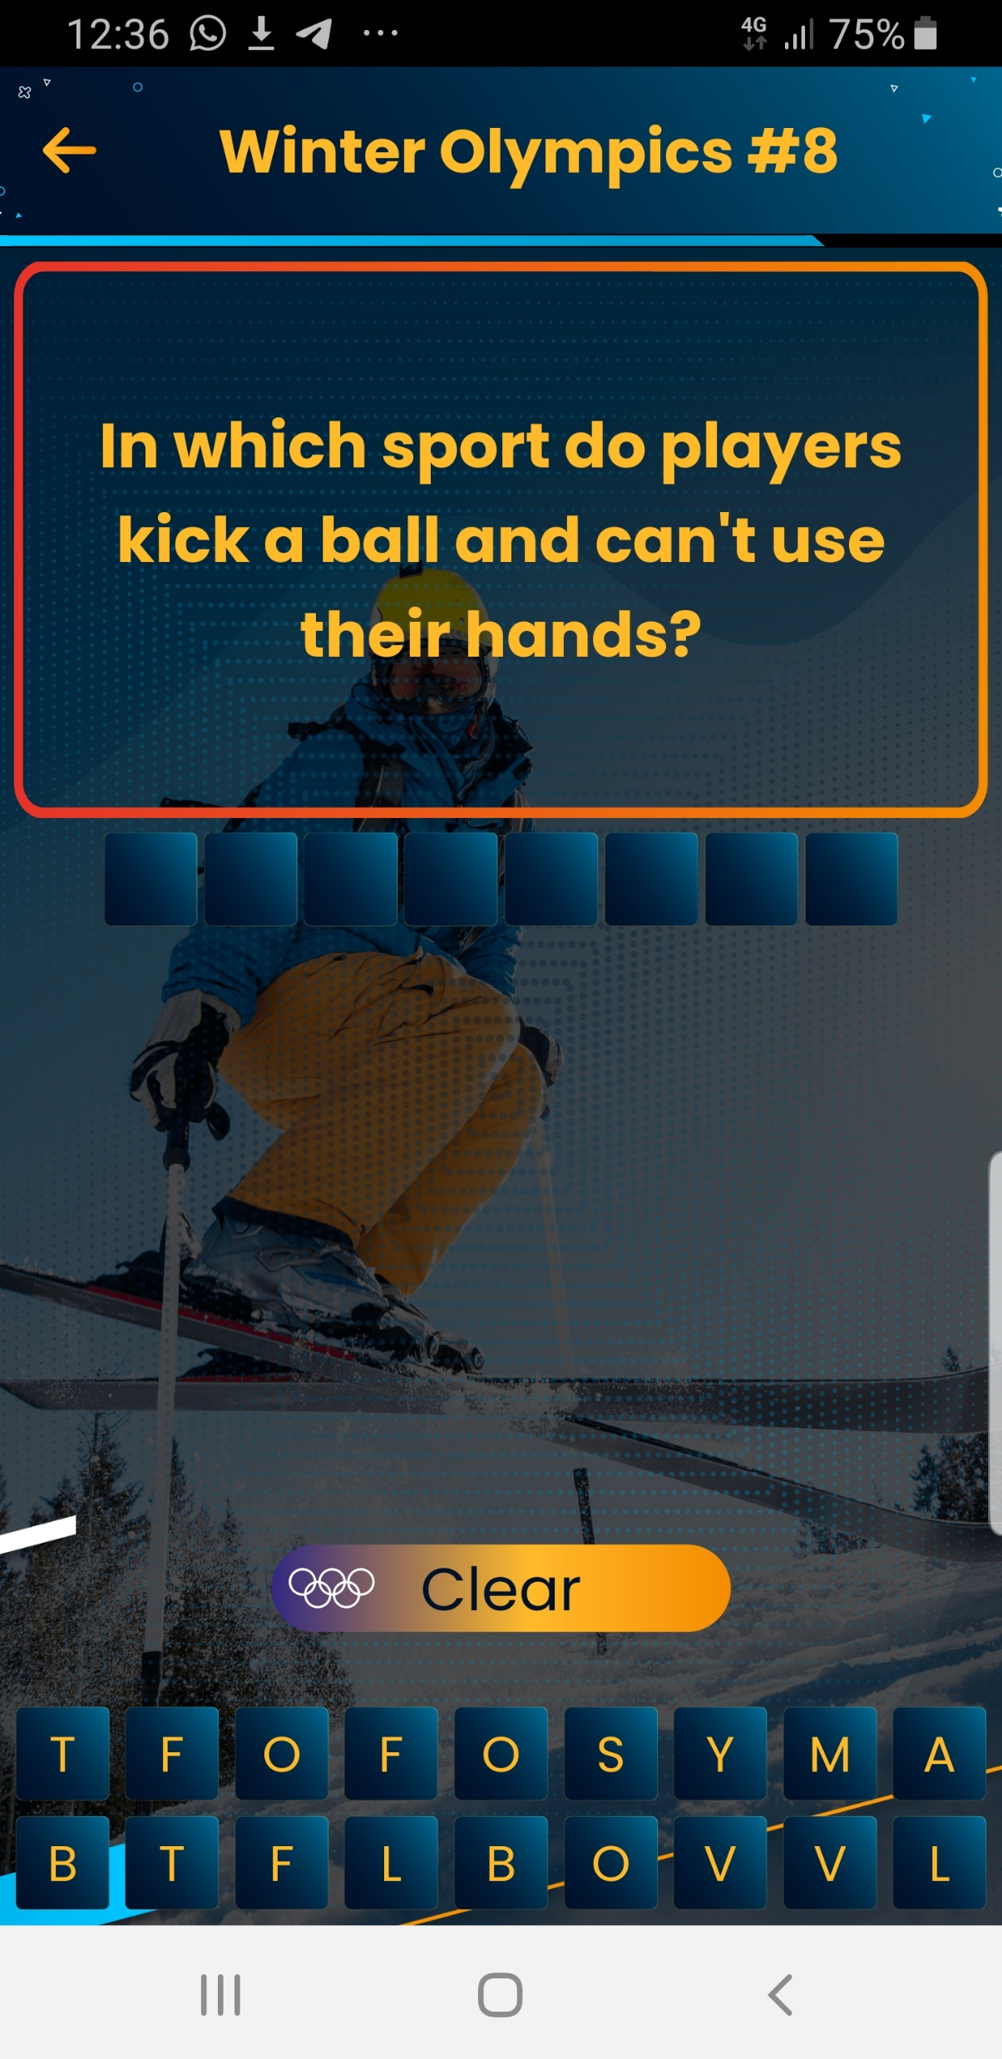
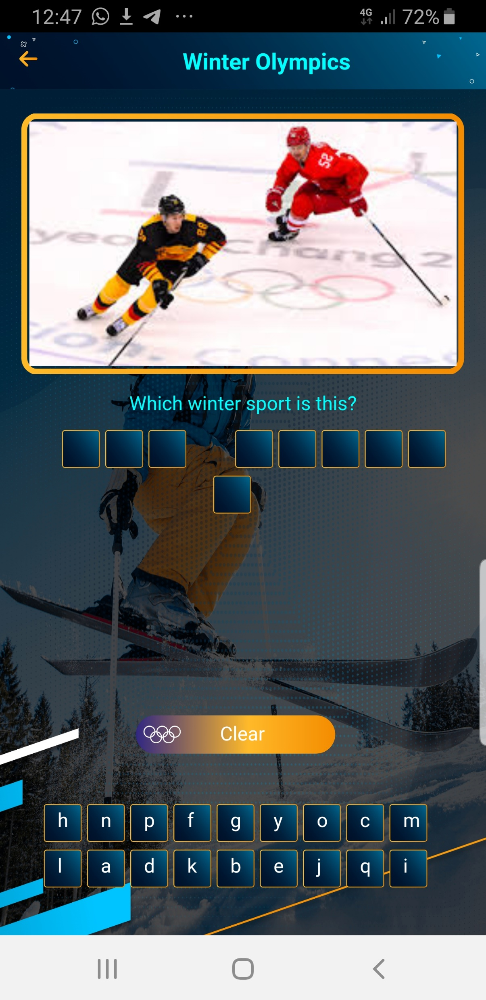
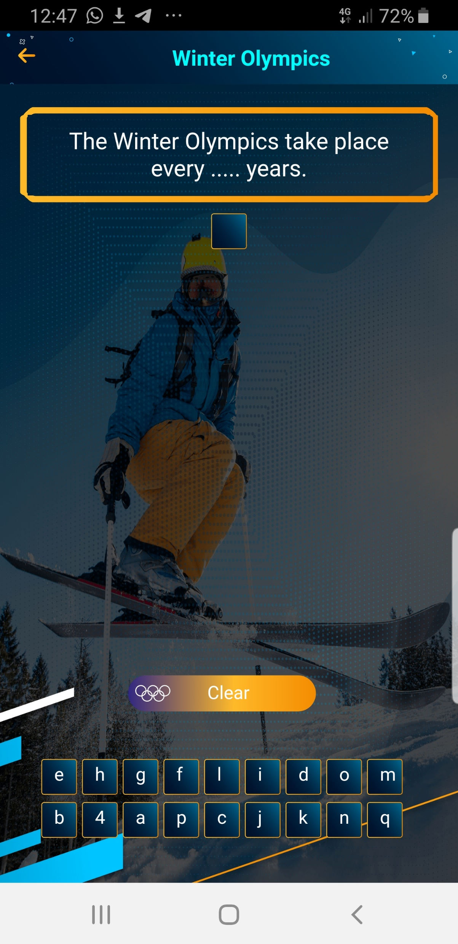
Original mobile app
New webapp
title is not centered
Font size and colors are not according to the original
Question screen look different then the original include the size of letter bank at the buttom
Letter bank- should be capital letters
Answers cannot cut in the middle

